Slide 1
Nuclear Medicine Physics
Basic Atomic and Nuclear Physics
Jerry Allison, Ph.D.
Department of Radiology and Imaging
Medical College of Georgia

Slide 2

Welcome to new residents 2017

Slide 3
Department of Radiology
Medical Physics Resources
Medical Physics Course
  Handouts
http://www.gru.edu/mcg/radiology/residency/resphysicscourse.php

Slide 4
What to learn?
ABR Core Exam Study Guide
  Physics
    17) Nuclear Medicine and Instrumentation
  Radioisotope Safety Examination (RISE)
https://www.theabr.org/wp-content/uploads/2017/07/CORE_Exam_Study_Guide_FINALV11.pdf

Slide 5
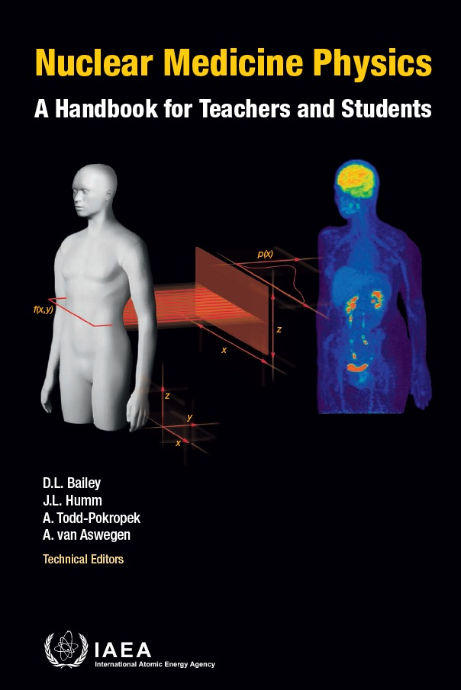

Wonderful new books (FREE)!
Nuclear Medicine Physics : A Handbook for Teachers and Students
Diagnostic Radiology Physics: A Handbook for Teachers and Students
International Atomic Energy Agency, 2014
http://www-pub.iaea.org/books/IAEABooks/Subject_Areas/0103/Medical-physics-including-dosimetry-

Slide 6
A note of thanks to
Z. J. Cao, Ph.D.
Medical College of Georgia
And
Sameer Tipnis, Ph.D.
G. Donald Frey, Ph.D.
Medical University of South Carolina
for
Sharing nuclear medicine presentation content

Slide 7
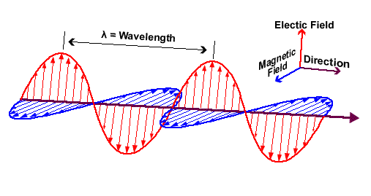
Electromagnetic wave
Oscillating electric field and perpendicularly oscillating magnetic field which propagate in vacuum at a speed of c = 3 × 10⁸ m/s (~ 1 ft/ns).
  amplitude
  phase
  wave length λ
  frequency ν
  λ.ν = c
c

Slide 8
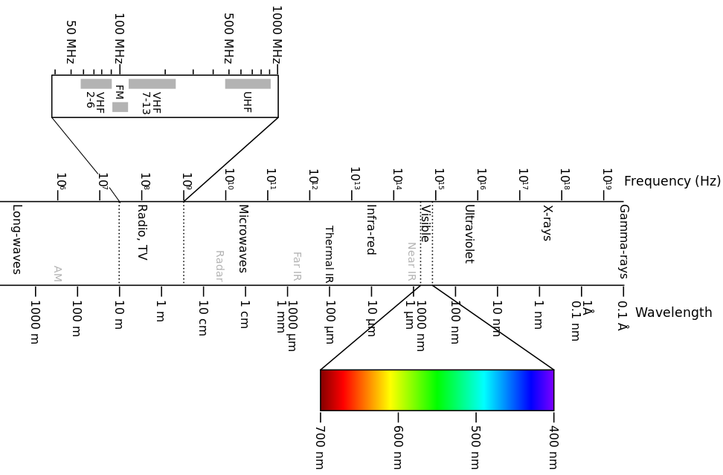
Spectrum of electromagnetic wave

Slide 9
Photons
Certain electromagnetic waves such as x-rays and γ-rays, can be characterized as quanta or photons.
Photons are like electron and proton particles but with no mass or electric charge.
A photon has energy and momentum.
Photon energy E = hν = hc/λ
Photon momentum p = E/c
  Planck’s constant h = 6.62 x 10⁻³⁴ J-sec
  Speed of light c = 3 × 10⁸ m/s (vacuum)

Slide 10
Atomic structure: Bohr model
Atom: the smallest part of an element
size ~ 10⁻⁸ cm
mass ~ 1 – 260 u
1 u = 1.66 x 10⁻²⁷ kg
1 u = 931 MeV (mass of H)
1 u ~ 1 GeV (mass of H)
charge = 0
  Equal numbers of protons and electrons
a nucleus at center and orbital electrons

Slide 11
Atomic structure: Bohr model
electron charge: -1 or -1.6 x 10⁻¹⁹ Coulomb
electron rest mass: 5.486×10⁻⁴ u
  electron mass energy equivalence: 511 keV
nuclear charge: +Z (atomic number)
Pauli exclusion principle:
  electrons allowed for an inner shell ≤ 2n² (n = 1, 2, 3, …)
  electrons allowed for an outer shell ≤ 8

Slide 12
Atomic force and energy
electron binding energy
  attractive electric force between the nucleus and electrons
binding energy
  energy needed to free an
  electron a few eV (H) to ~100 keV (U)
  decreases with distance
  from nucleus(outer orbits)
  decreases with smaller
  nuclear charge
E₁ = -10 eV
E₂ = -5 eV

Slide 13
Transition of orbital electrons
Inner shell electron vacancies are filled by outer shell electrons, releasing the difference in binding energies
The energy difference
results in
  emission of characteristic
  x-rays, or
  emission of Auger
  electrons

Slide 14
Characteristic x-rays and Auger electrons
E₂
=
-5
e
V
E₁
=
-2
0
e
V
15 eV
x
-
r
a
y
10 eV
A
u
g
e
e⁻
r

Slide 15
Emission of bremsstrahlung
An incident electron is decelerated and deflected by the nucleus. The energy loss is emitted as bremsstrahlung (braking radiation).
The bremsstrahlung carries energy from 0 up to the full energy of the incident electron.
bremsstrahlung
energy spectrum
x-ray intensity
100 keV e⁻
0 25 50 75 100
x-ray energy (keV)

Slide 16
Question
Tungsten has electron binding energies of k = 69 keV, l = 12 keV and m = 2 keV.
If a k shell electron is removed, which emissions could occur?
1. 57 keV characteristic x-ray
2. 10 keV characteristic x-ray
A. 1 only
B. 2 only
C. 1 and 2
C. 1 and 2 is CORRECT

Slide 17
Question
Consider an atom with electron binding energies of k = 30 keV, l = 4 keV. An Auger electron is ejected from the l shell as following an electron transition from l to k. The energy of the Auger electron is ______ keV.
A. 30
B. 26
C. 22
D. 4
C. 22 is CORRECT

Slide 18
Nuclear structure
nucleus size ≈ 10⁻¹³ cm
nucleus mass: 1 - 230 u
composed of protons and neutrons (nucleons)
mass number A = Z + N
Z: proton number (atomic number)
N: neutron number
A: nucleon number
proton charge: +1
neutron charge: 0

Slide 19
Nuclear structure
^{A}X_{Z} or X-A e.g. ⁹⁹Tc₄₃ or Tc-99
isotopes: same Z but different N
¹H₁ and ²H₁, ¹⁵O₈ and ¹⁶O₈
isobars: same A but different Z
¹⁴C₆ and ¹⁴N₇
isotones: same N (# neutrons) but different Z
³H₁ and ⁴He₂
isomers: same A and Z but different energy ^{99m}Tc₄₃ and ⁹⁹Tc₄₃

Slide 20
Two forces inside nucleus
electric force between protons: repulsive
nuclear force between nucleons: strong and shortly ranged attraction that keeps a nucleus together
The nuclear force produces the binding energy (~ 8 MeV) for a nucleon.
If < 8 MeV, a nucleus is in an excited energy state.
Notes:
Electromagnetic force
Strong force
Weak force
Gravitational force
The strong interaction is very strong, but very short-ranged. It acts only over ranges of order 10-13 centimeters and is responsible for holding the nuclei of atoms together. It is basically attractive, but can be effectively repulsive in some circumstances.
The electromagnetic force causes electric and magnetic effects such as the repulsion between like electrical charges or the interaction of bar magnets. It is long-ranged, but much weaker than the strong force. It can be attractive or repulsive, and acts only between pieces of matter carrying electrical charge.
The weak force is responsible for radioactive decay and neutrino interactions. It has a very short range and, as its name indicates, it is very weak.
The gravitational force is weak, but very long ranged. Furthermore, it is always attractive, and acts between any two pieces of matter in the Universe since mass is its source.

Slide 21
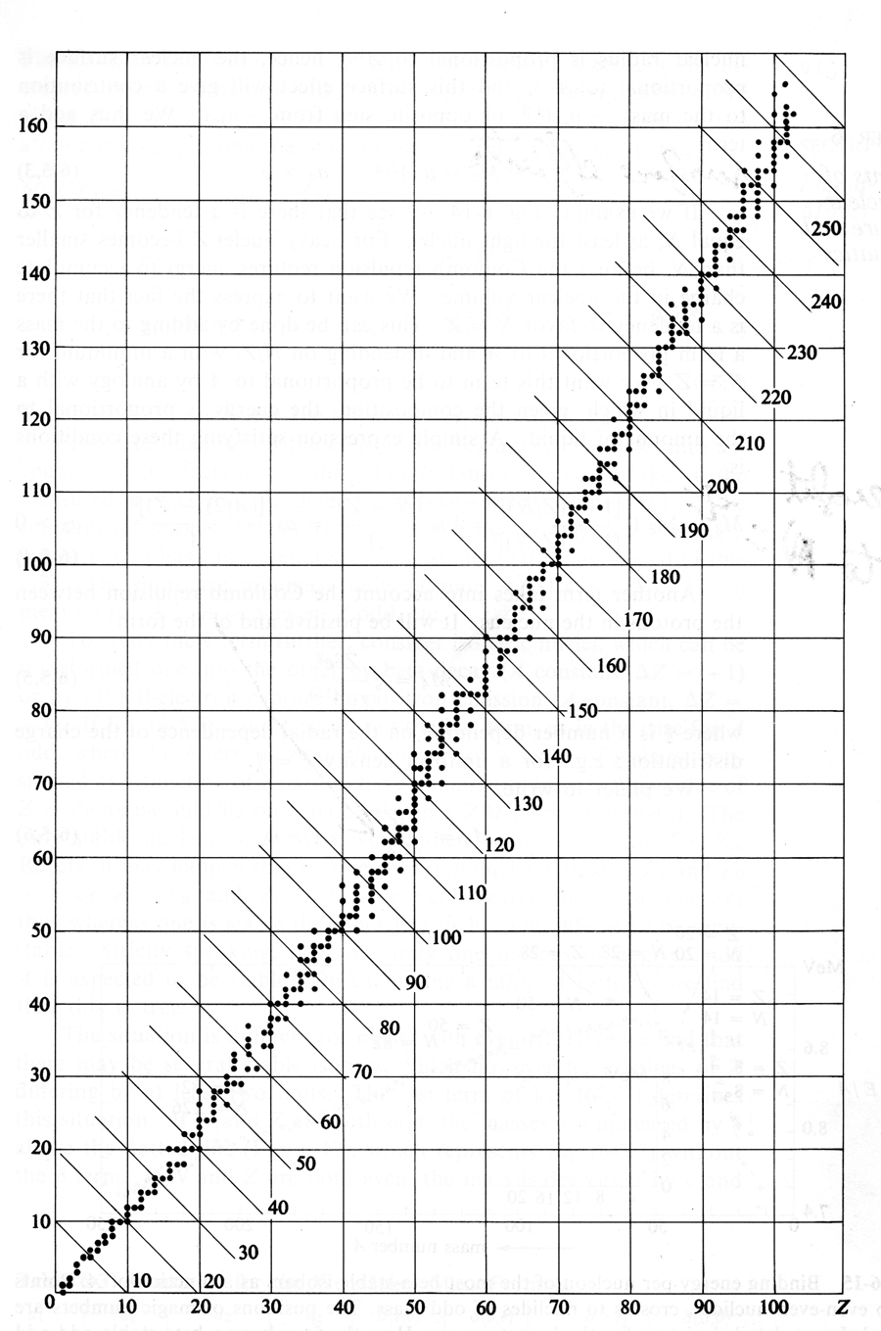
Line of Stability
N
Naturally occurring (stabile) nuclides
These nuclei have a stable configuration of protons and neutrons in the nucleus
Stable nuclides
  C-12 (6,6)
  O-16 (8,8)
  I-127 (53, 74)
Z

Slide 22
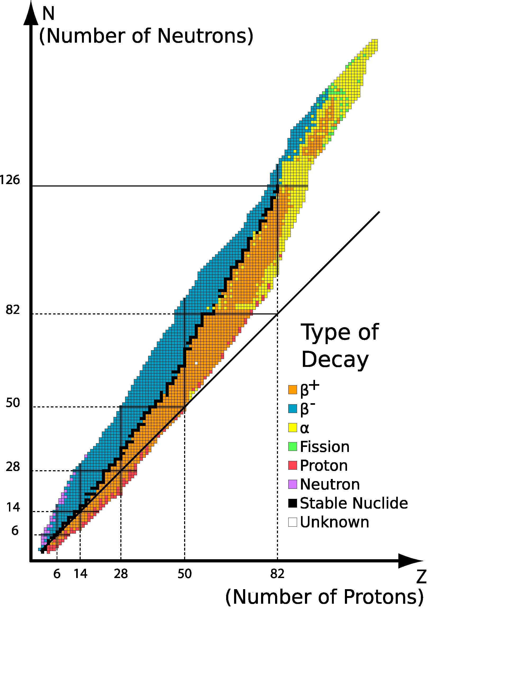
Radionuclides
Many nuclei are not stable (radioactive)
Radionuclides close to line of stability
  Return by beta decay and electron capture
  Radionuclides above the line
    β⁻ (e.g. I-131)
  Radionuclides below the line
    β⁺ (e.g. F-18) and EC (e.g. Tl-201)
https://commons.wikimedia.org/wiki/File%3ATable_isotopes_en.svg

Slide 23
Nuclear decay
must obey the conservation laws (energy-mass, electric charge, momentum, etc)
to approach a stable N/Z ratio by
  1. emission of charged particles (β⁻, β⁺, α)
  2. capture of orbital electrons
  3. fission
to release extra energy by
1. γ decay (isomeric transition)
2. internal conversion

Slide 24
β⁻ decay
A neutron decays to a proton, electron and anti- neutrino: n → p + e⁻ + ∼ν
e⁻ and ∼ν created inside
the nucleus at the
moment of decay and
ejected right away:
e.g.
⁹⁹Mo₄₂ → ^{99m}Tc₄₃ + e⁻ + ∼ν
¹³¹I₅₃ → ¹³¹Xe₅₄ + e⁻ + ∼ν
e⁻
∼ν

Slide 25
β⁻ decay
for neutron rich isotopes
γ-ray emission or internal conversion follows if the child nucleus is in an excited state.

Slide 26
β⁺ decay
A proton decays to a neutron, positron and neutrino: p → n + e⁺ + ν
e⁺ and ν created in the
nucleus at the moment
of decay and ejected
right away
e.g.
¹⁸F₉ → ¹⁸O₈ + e⁺ + ν
¹⁵O₈ → ¹⁵N₇ + e⁺ + ν
e⁺
ν

Slide 27
β⁺ decay
β⁺ decay for proton rich isotopes
γ-ray emission or internal conversion follows if the child nucleus is in an excited state.

Slide 28
Annihilation
e⁻ + e⁺ => 2 γ
or
e⁻ + β⁺ => 2 γ
each γ has energy: 511 keV due to energy-mass conservation or
2 γ’s always traveling in opposite directions due to momentum conversation
→ PET imaging

Slide 29
Electron capture
primary: an orbital electron is absorbed into nucleus and is immediately combined with a proton to form a neutron and neutrino:
e⁻ + p → n + ν
e.g. ⁷Be₄ + e⁻ → ⁷Li₃ + ν
secondary: emission of
characteristic x-rays or
Auger electrons
x-ray
Auger e⁻
ν

Slide 30
Electron capture
for proton rich nuclei
competing with β⁺ decay, both produce the same nuclear change of Z to Z-1
probability increasing with larger Z due to closer electron shells

Slide 31
γ decay (isomeric transition)
emitting a γ photon to release extra energy of the nucleus: excited state → ground state
^{99m}Tc₄₃ → ⁹⁹Tc₄₃ + γ
γ photon ejected
out of the nucleus
It often follows other decays that result in an unstable nucleus.
γ-ray
Notes:
A metastable state has a half-life greater than 10^-12 seconds
“meta” from the greek means almost ---→ almost stable

Slide 32
Internal conversion I.C.
primary: ejection of an orbital electron to release extra energy of the nucleus
no γ photons
emitted
secondary:
emission of
x-rays or
Auger e⁻ due to
orbital e⁻ transition
x-ray
conversion e⁻
Auger e⁻

Slide 33
Internal conversion I.C.
competes with γ-decay
highest probability for k-shell electrons but other shells possible
It often follows other decays that result in an unstable nucleus.

Slide 34
α decay
emission of a helium nucleus or α particle
(α: 2 p + 2 n)
²²⁶Ra₈₈ → ²²²Rn₈₆ + ⁴He₂
²³⁵U₉₂ → ²³¹Th₉₀ + ⁴He₂
occurring for heavy
nuclei
It is often followed
by γ-decay or I.C.
α

Slide 35
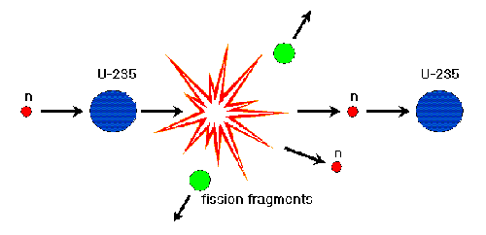
Fission
A heavy nucleus breaks into two fragments (usual mass ratio: 40:60).
²³⁵U₉₂ + n → ⁹²Kr₃₆ + ¹⁴¹Ba₅₆ + 3n + 200 MeV

Slide 36
Fission
low probability for ²³⁵U spontaneous fission (T_{1/2} = 2×10¹⁷y) so neutrons are needed to initiate the fission
Once started, each fission produces more neutrons (1:3) which can sustain fission (chain reaction).
most energy released as heat, also kinetic energies for the fragments and n (~ 1.5 MeV)
controllable in reactor and uncontrolled in atomic bomb

Slide 37
Nuclear decay rules
Based on conservation laws
γ-decay and internal conversion: no changes for A & Z
β⁻-decay: ^{A}X_{Z} → ^{A}Y_{Z+1} + e⁻ + ∼ν
β⁺-decay: ^{A}X_{Z} → ^{A}Y_{Z-1} + e⁺ + ν
e-capture: ^{A}X_{Z} + e⁻ → ^{A}Y_{Z-1} + ν
α-decay: ^{A}X_{Z} → ^{A-4}Y_{Z-2} + α

Slide 38
Nuclear decay scheme
⁹⁹Mo₄₂ → ^{99m}Tc₄₃ + e⁻ + ν (87.6%)
^{99m}Tc₄₃ → ⁹⁹Tc₄₃ + γ
9
9
m
T
c
4
3
(6.01 h)
1
4
2
.
7
k
e
V
γ₁
9
9
%
1
4
0
.
5
k
e
V
γ
γ
2
I
.
C
.
3
8
9
%
1
1
%
1
%
0
9
9
T
c
4
3
(2.111x10⁵ y)

